Slide 1
Semiconductor
Diodes
Lecture2

Slide 2
Intrinsic Semiconductors
Conductivity between conductors and insulators
Two kinds of semiconductors:
  Single-element such as germanium and silicon, in group IV
  Compound such as gallium-arsenide, groups III and V or groups II and VI
    for special electronic circuit applications and in applications that involve light

Slide 3
Intrinsic Semiconductors
At 0 K, all the covalent bonds intact
No electrons available to conduct electric current and silicon crystal behaves as an insulator

Slide 4
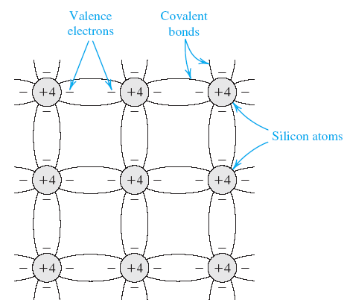
Intrinsic Semiconductors

Slide 5
Intrinsic Semiconductors
At room temperature, sufficient thermal energy exists to break some of the covalent bonds a process known as thermal generation

Slide 6
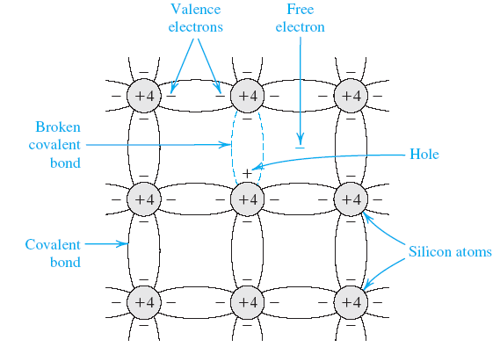
Intrinsic Semiconductors

Slide 7
Intrinsic Semiconductors
When a covalent bond is broken, an electron is freed
The free electron can wander away from its parent atom, and it becomes available to conduct electric current if an electric field is applied to the crystal

Slide 8
Intrinsic Semiconductors
As the electron leaves its parent atom, it leaves behind a net positive charge, equal to the magnitude of the electron charge
So an electron from a neighboring atom may be attracted to this positive charge and leaves its parent atom

Slide 9
Intrinsic Semiconductors
This action fills up the “hole” that existed in the ionized atom but creates a new hole in the other atom
This process may repeat itself, and we have a positively charged carrier, or hole, moving through the silicon crystal structure and being available to conduct electric current

Slide 10
Intrinsic Semiconductors
As temperature increases, more covalent bonds are broken and electron–hole pairs are generated
The increases the conductivity of silicon
Thermal generation gives free electrons and holes in equal numbers and equal concentrations

Slide 11
Intrinsic Semiconductors
The free electrons and holes move randomly through the silicon crystal structure, and in the process some electrons may fill some of the holes
This process is called recombination

Slide 12
Intrinsic Semiconductors
Recombination results in the disappearance of free electrons and holes
The recombination rate is proportional to the number of free electrons and holes, which in turn is determined by the thermal generation rate
Thermal generation is a strong function of temperature

Slide 13
Intrinsic Semiconductors
In thermal equilibrium, the recombination rate is equal to the generation rate
So we conclude that the concentration of free electrons n is equal to the concentration of holes p

Slide 14
Intrinsic Semiconductors
is the number of free electrons and holes in a unit volume (cm3) of intrinsic silicon at a given temperature

Slide 15


Intrinsic Semiconductors
B=
Eg= 1.12 eV
k = Boltzmann’s constant=
Eg=minimum energy required to break a covalent bond and generate an electron hole pair

Slide 16


Intrinsic Semiconductors
Product of the hole and free-electron concentration
For silicon at room temperature

Slide 17
Doped Semiconductors
Concentrations of free carriers, generated by thermal generation very small to conduct appreciable current at room temperature
Also, the carrier concentrations and hence the conductivity are strong functions of temperature, not a desirable property in an electronic device

Slide 18
Doped Semiconductors
A method developed to change the carrier concentration in a semiconductor crystal substantially and in a precisely controlled manner
This process is known as doping, and the resulting silicon is referred to as doped silicon

Slide 19
Doped Semiconductors
Doping involves introducing impurity atoms into the silicon crystal in sufficient numbers to substantially increase the concentration of either free electrons or holes but with little or no change in the crystal properties of silicon

Slide 20
Doped Semiconductors
To increase the concentration of free electrons,n, silicon is doped with an element with a valence of 5, such as phosphorus
The resulting doped silicon is of n type

Slide 21
Doped Semiconductors
To increase the concentration of holes, p, silicon is doped with an element having a valence of 3, such as boron
The resulting doped silicon is of p type

Slide 22
Doped Semiconductors
A silicon crystal doped with phosphorus impurity
The dopant (phosphorus) atoms replace some of the silicon atoms in the crystal structure
Four of the electrons of phosphorus atom form covalent bonds with the neighboring atoms, and the fifth electron becomes a free electron

Slide 23
Doped Semiconductors
Thus each phosphorus atom donates a free electron to the silicon crystal, and the phosphorus impurity is called a donor
It should be clear, though, that no holes are generated by this process
The positive charge associated with the phosphorus atom is a bound charge that does not move through the crystal

Slide 24
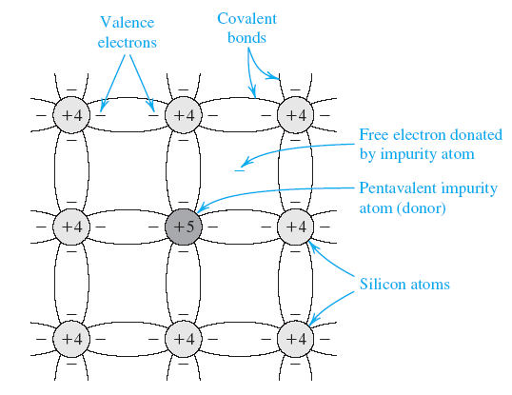
Doped Semiconductors

Slide 25

Doped Semiconductors
If the concentration of donor atoms is
Usually >> n_{i}
The concentration of free electrons in the n-type silicon will be
subscript _{n} denotes n-type silicon
n_{n} determined by the doping concentration and not by temperature

Slide 26
Doped Semiconductors
Not so for the hole concentration as all holes in the n-type silicon generated by thermal ionization

Slide 27


Doped Semiconductors
Hole concentration can be found by noting that the relationship for intrinsic semiconductors applies equally well for doped silicon, provided thermal equilibrium is achieved
Thus for n-type silicon

Slide 28
Doped Semiconductors
p_{n} will have the same dependence on temperature as that of n_{i}.

Slide 29
Doped Semiconductors
Important
  In n-type silicon concentration of free electrons will be much larger than that of holes
  Hence electrons are said to be the majority charge carriers and holes the minority charge carriers in n-type silicon

Slide 30
Doped Semiconductors
For p-type silicon in which holes are the majority charge carriers, a trivalent impurity such as boron is used
Boron atoms replace some of the silicon atoms in the silicon crystal structure
Each boron atom has three electrons in its outer shell, it accepts an electron from a neighboring atom, to form covalent bonds

Slide 31
Doped Semiconductors
The result is a hole in the neighboring atom and a bound negative charge at the acceptor (boron) atom
Each acceptor atom provides a hole

Slide 32
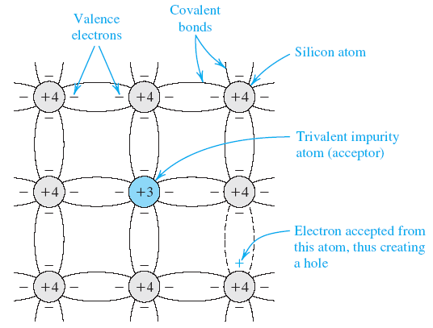
Doped Semiconductors

Slide 33


Doped Semiconductors
If the acceptor doping concentration is
where the hole concentration becomes

Slide 34

Doped Semiconductors
The subscript p denotes p-type silicon

Slide 35

Doped Semiconductors
Thus, here the majority carriers are holes and their concentration is determined by N_{A}
Concentration of the minority electrons will have the same temperature dependence as that of n_{i}

Slide 36
Doped Semiconductors
It should be emphasized that a piece of n-type or p-type silicon is electrically neutral;
The charge of the majority free carriers (electrons in the n-type and holes in the p-type silicon) are neutralized by the bound charges associated with the impurity atoms

